Slide 1
Programming OOP Final Project{
OOP Final Project.class
so_tired.html
[Automatic Volleyball Recorder]
<組員: 吳堃豪 許馨文 張奕奇 邱郁宸>
}
OOP Final Project 110-2

Slide 2
Contents Of Project
Volleyball.html
Introduction.css
Background and Motivation
Automatic Recorder for Volleyball
Framework
Introduction for Classes and Logic
WBS
Network/Timeline
Teamwork
OOP Final Project 110-2

Slide 3
Background and Motivation{
01
02
Volleyball.html
Introduction.css
Group Members
< One team manager and
three players on the team>
Complexity
< We found that it’s complicated to record and a lot of procedures>
}
OOP Final Project 110-2

Slide 4
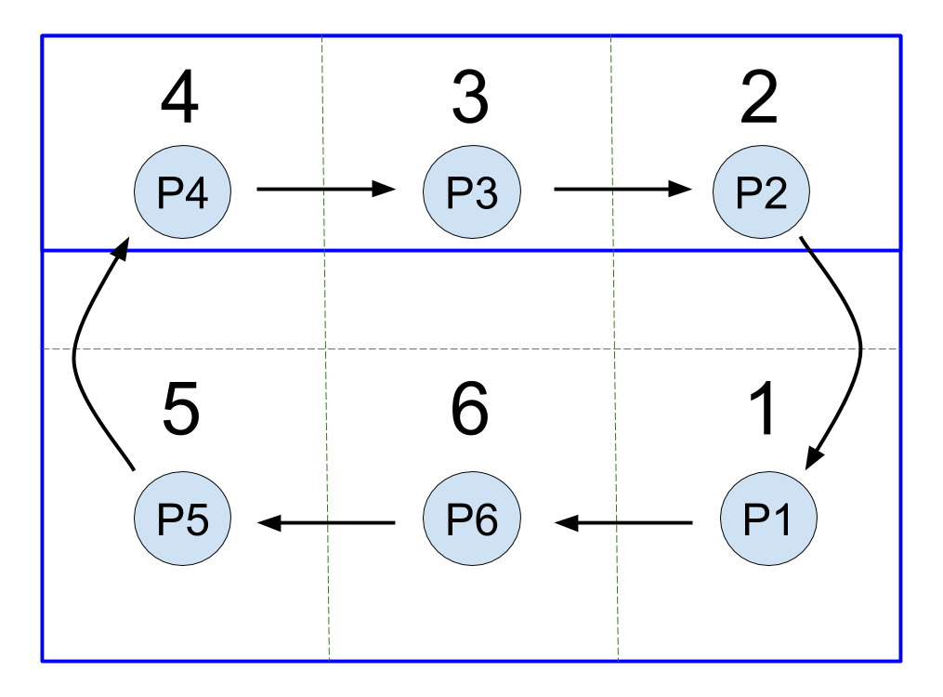
Automatic Recorder for Volleyball{
Volleyball.html
Introduction.css
-> Total scores
-> Personal scores
(Block/Serve/Spike)
-> Timeouts
-> Errors
->The rotation order
changes by the time
}
OOP Final Project 110-2

Slide 5
Framework{
Volleyball.html
Introduction.css
Players
Tester
LoginPage
FirstPage
ScoreManager
SecondPage
}
OOP Final Project 110-2

Slide 6
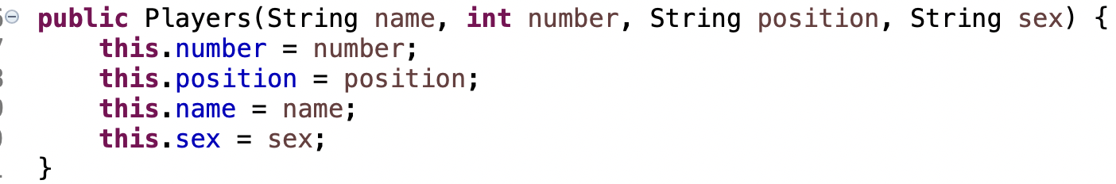
Introduction for Class and Logic{
Volleyball.html
Introduction.css
<Players>
=> To record the basic data of every player.
}
OOP Final Project 110-2

Slide 7

Introduction for Class and Logic{
Volleyball.html
Introduction.css
<Tester>
}
“Only purpose: Open the LoginPage”
OOP Final Project 110-2

Slide 8
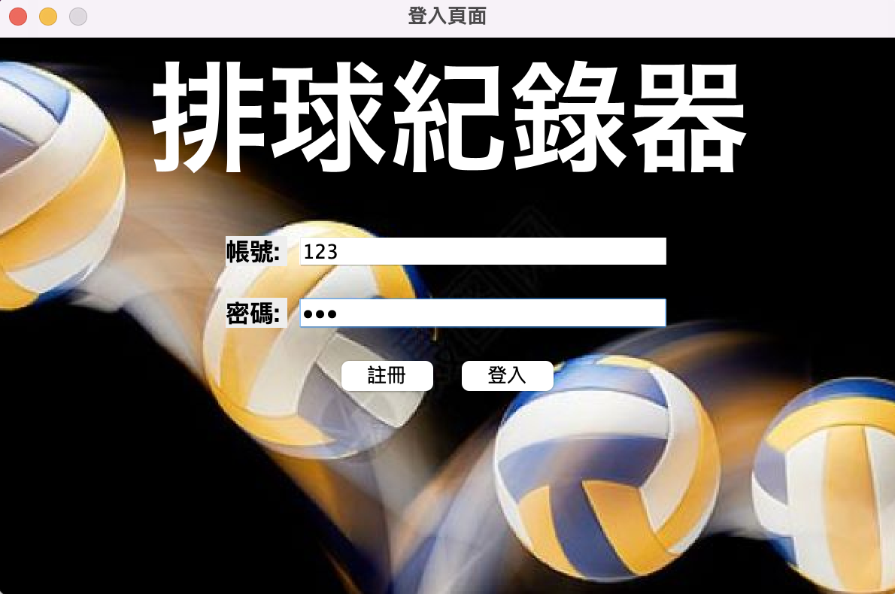
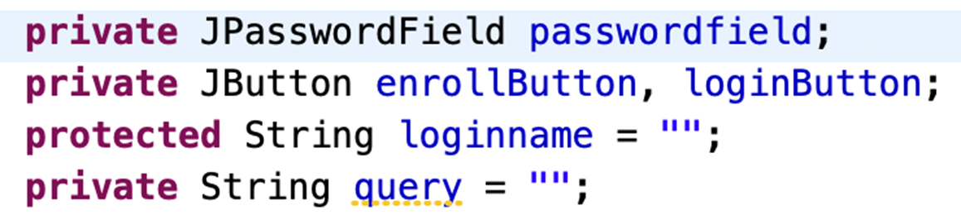
Introduction for Class and Logic{
Volleyball.html
Introduction.css
<LoginPage>
“To Present the LoginPage and let users to key in their account and passwords”
“PasswordField could cover the passwords which
makes it safer”
}
OOP Final Project 110-2

Slide 9
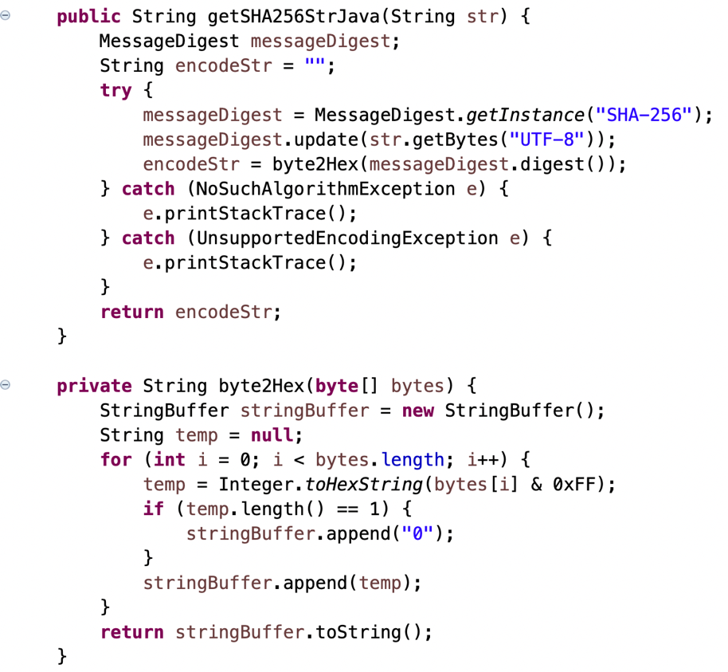
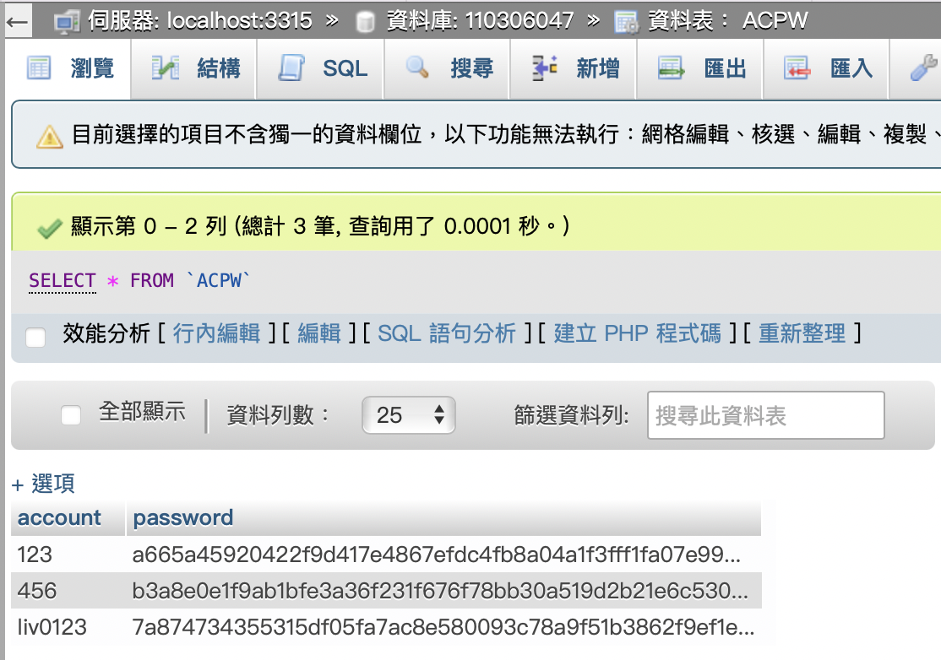
Introduction for Class and Logic{
Volleyball.html
Introduction.css
<LoginPage>
“Using SHA-256 to encrypt, upload the ciphertext instead of plaintext”
}
OOP Final Project 110-2

Slide 10
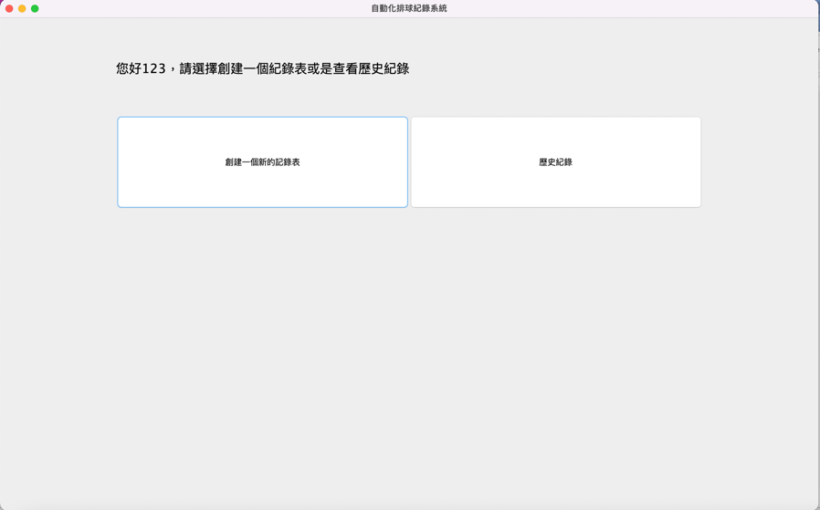
Introduction for Class and Logic{
Volleyball.html
Introduction.css
<FirstPage>
“Choose either 查看歷史紀錄 or 創建新的記錄表”
}
OOP Final Project 110-2

Slide 11
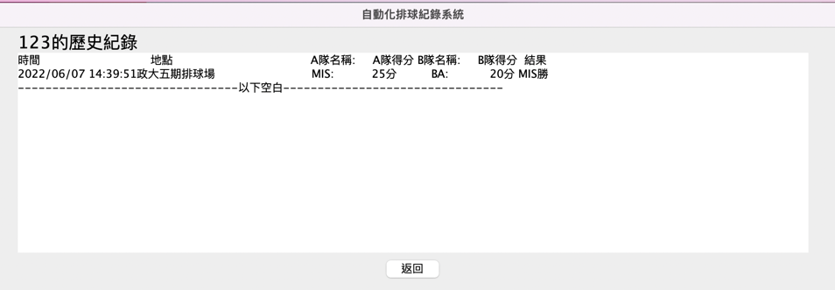
Introduction for Class and Logic{
Volleyball.html
Introduction.css
<FirstPage>
“查看歷史紀錄”
“SELECT DATA FROM SQL where account == ’accountname’”
}
OOP Final Project 110-2

Slide 12
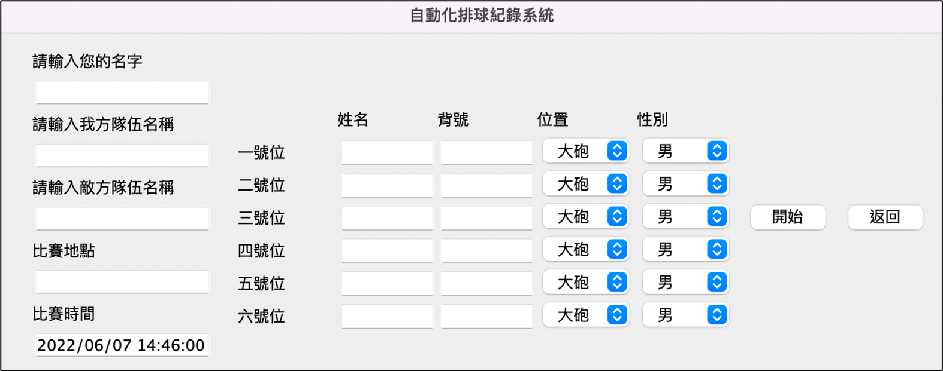
Introduction for Class and Logic{
Volleyball.html
Introduction.css
<FirstPage>
“創建新的記錄表”
“key in player‘s data, sex and their locations”
*In order to be used in the Mixed Cup, we added the option of Female
*Using DateTimeFormatter and LocalDateTime.now() to get the time
}
OOP Final Project 110-2

Slide 13
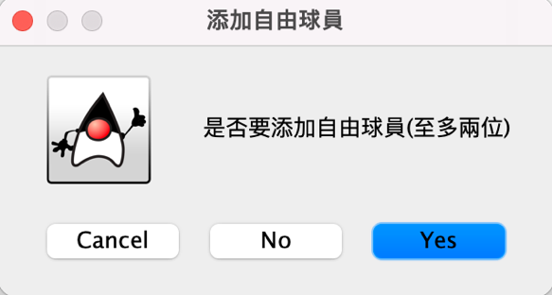
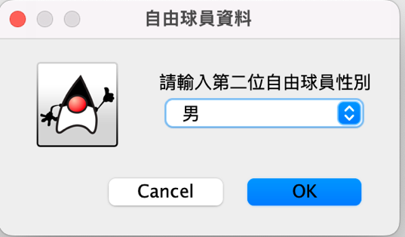
Introduction for Class and Logic{
Volleyball.html
Introduction.css
<FirstPage>
“是否加入自由球員及其資料”
}
OOP Final Project 110-2

Slide 14
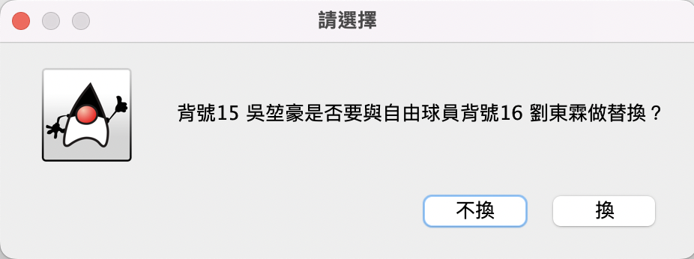
Introduction for Class and Logic{
Volleyball.html
Introduction.css
<FirstPage>
“The system would detect if there are middleblockers and asks for substitutions”
}
OOP Final Project 110-2

Slide 15
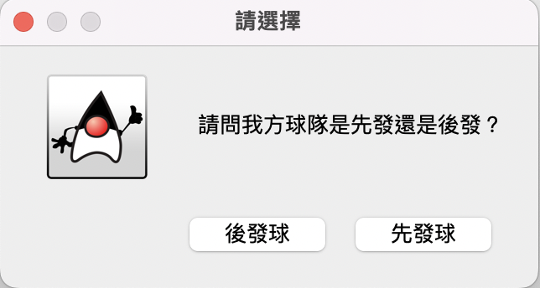
Introduction for Class and Logic{
Volleyball.html
Introduction.css
<FirstPage>
“To decide the server order which would affect the decoration of the Labels and Logic later”
}
OOP Final Project 110-2

Slide 16
Introduction for Class and Logic{
Volleyball.html
Introduction.css
<ScoreManager>
“Designed to deal with logical and arithmetical issues”
判斷輪轉/發球邏輯
進行個別球員資料之紀錄
（發球得分、攔網得分、攻擊得分、失誤失分）
判斷輸贏邏輯(包括deuce)
紀錄總體得分分佈
（我方得分/敵方失誤導致我方得分/我方受迫性失誤失分）
}
OOP Final Project 110-2

Slide 17
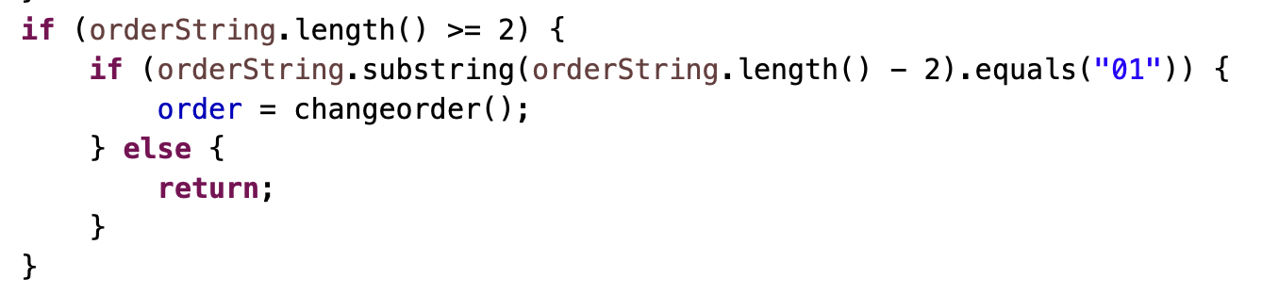
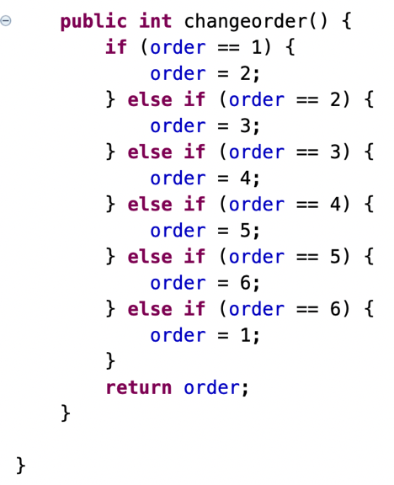
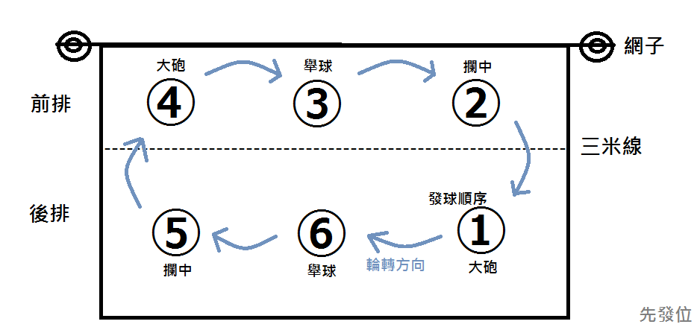
Introduction for Class and Logic{
Volleyball.html
Introduction.css
<ScoreManager>
“排球規則：發球員擊球過網進⼊對區，雙⽅來回對擊，直至球落地、出界或某隊未能合法將球擊回對區”
“輪轉規則：當我方失分後再次獲得發球權，球員順時針輪轉一個位置”
}
OOP Final Project 110-2

Slide 18
Introduction for Class and Logic{
Volleyball.html
Introduction.css
<SecondPage>
“To record data by just clicking them...”
自動計分
進行輪轉
判斷勝負
匯出報表(.csv)
}
OOP Final Project 110-2

Slide 19
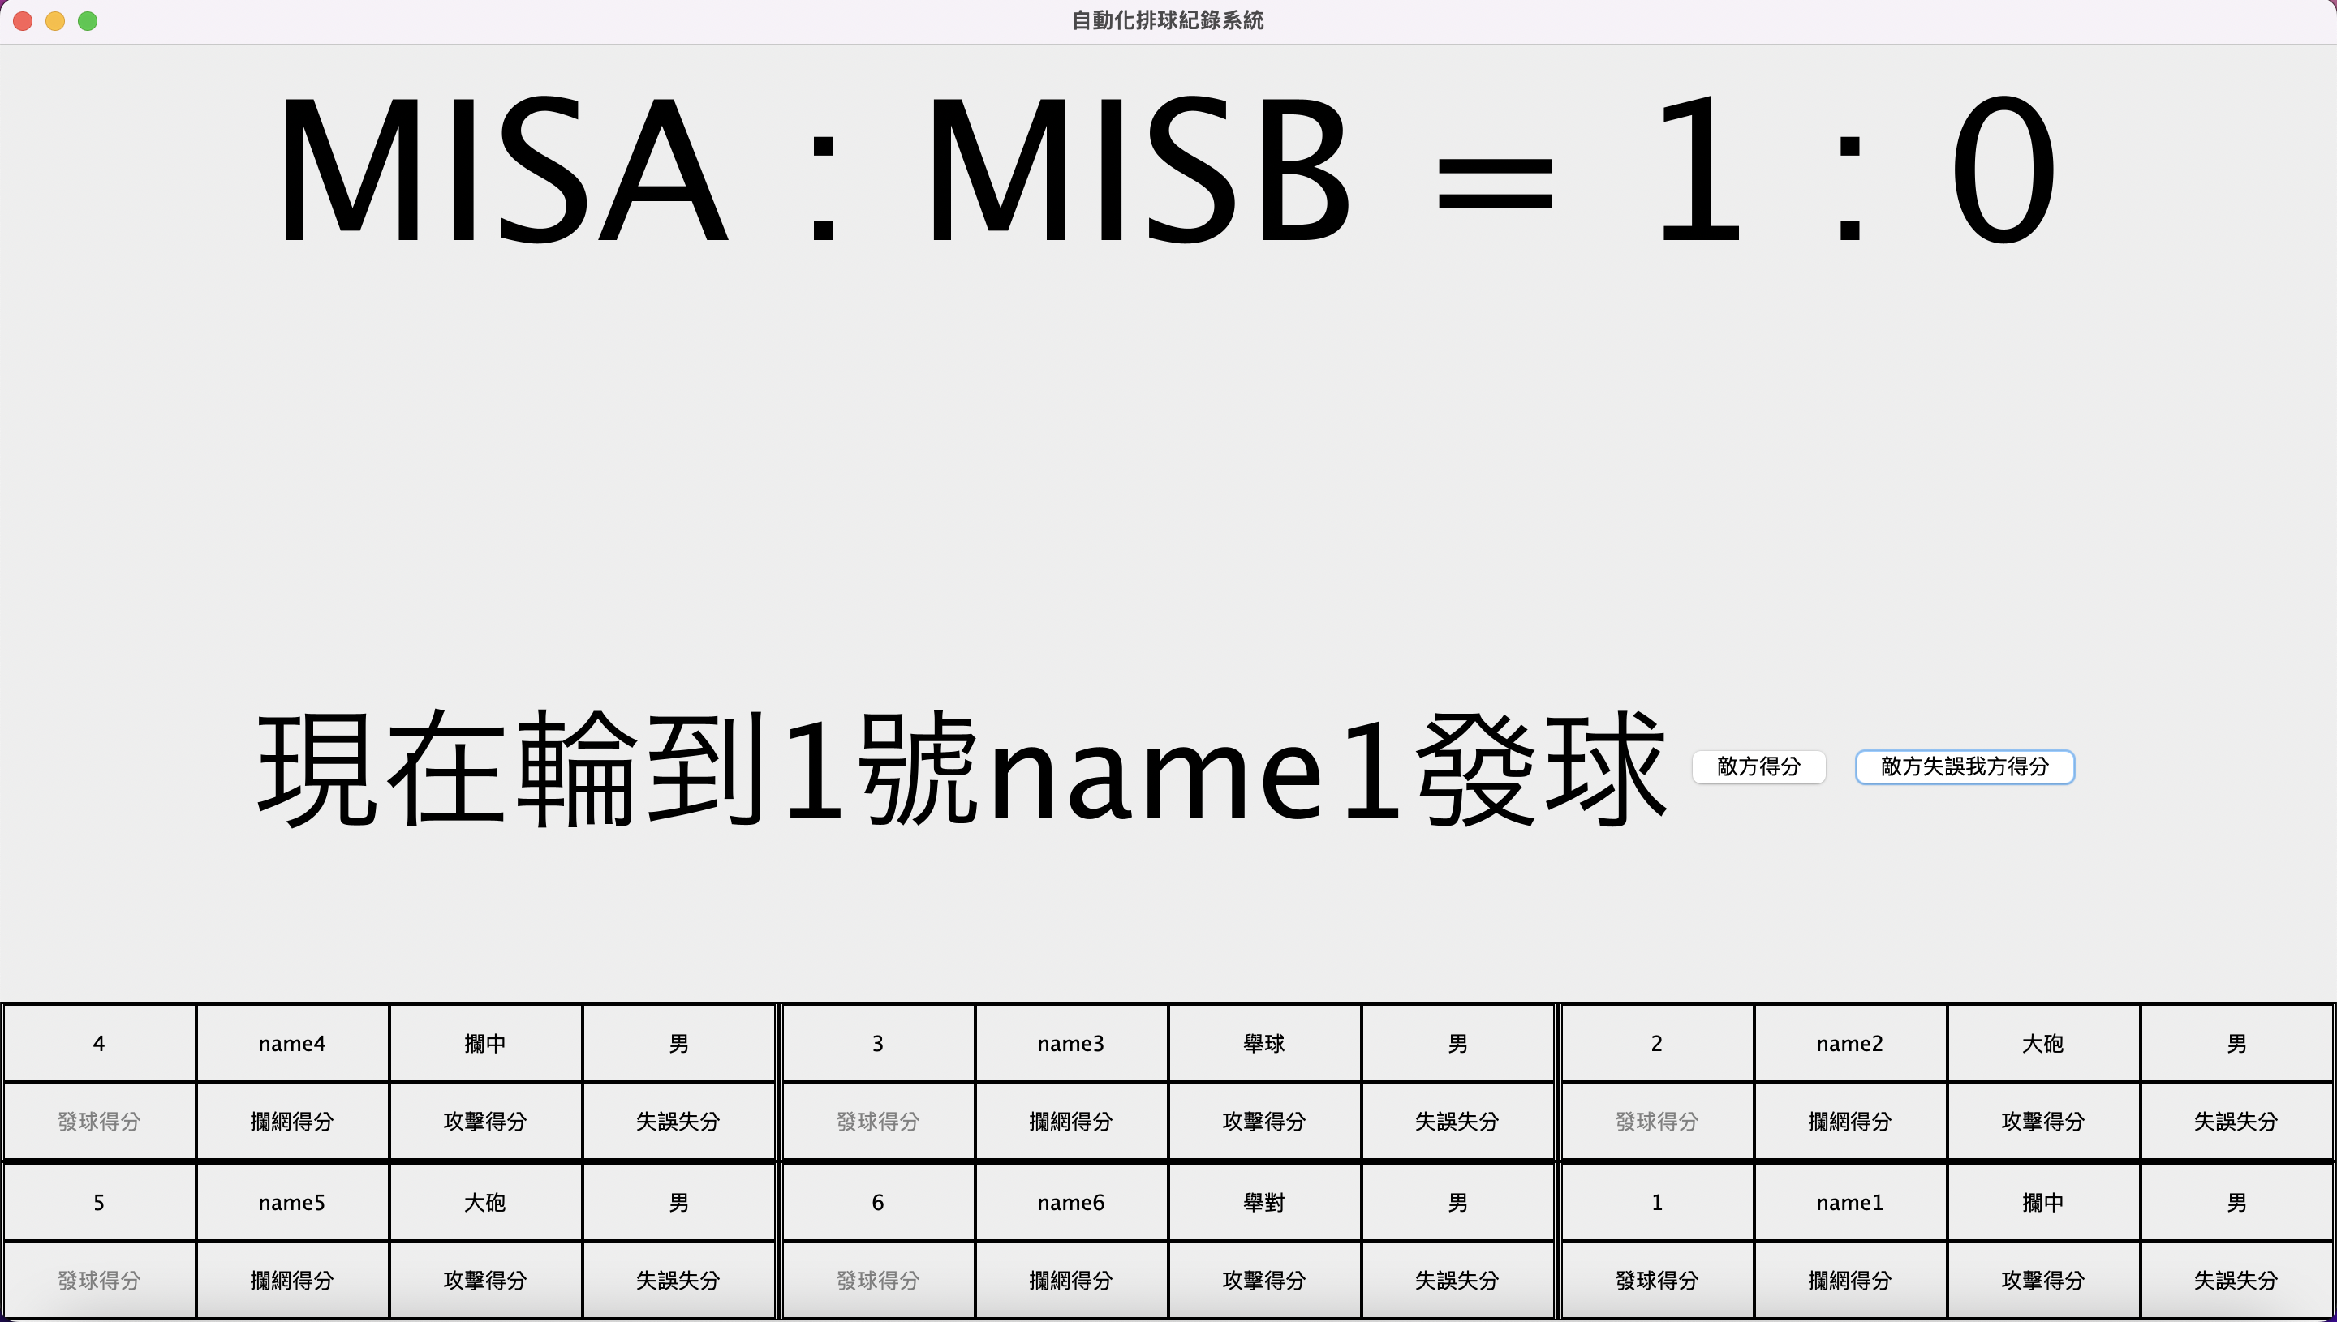
Introduction for Class and Logic{
Volleyball.html
Introduction.css
<SecondPage>
“Whole Layout”
}
OOP Final Project 110-2

Slide 20

Introduction for Class and Logic{
Volleyball.html
Introduction.css
<SecondPage>
“Using the ArrayList of the FirstPage as the SecondPage’s constructor’s parameter to send infos”
}
OOP Final Project 110-2

Slide 21
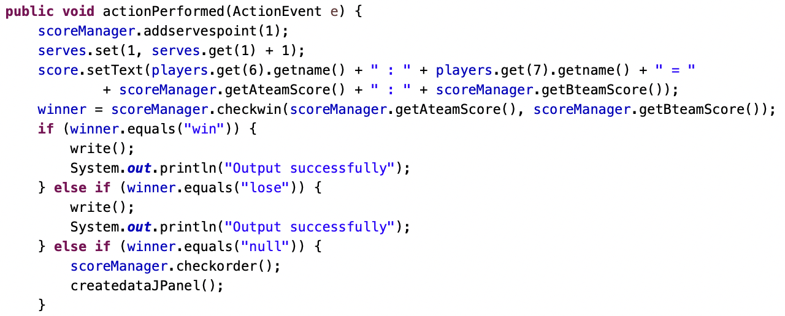
Introduction for Class and Logic{
Volleyball.html
Introduction.css
<SecondPage>
“Callback listener”
}
OOP Final Project 110-2

Slide 22
Introduction for Class and Logic{
Volleyball.html
Introduction.css
<SecondPage>
“Callback listener”
01
若為得分則在總得分+1，得分球員個人的資料也會+1(serves的ArrayList, set(number, +1分))
02
加分後重新載入計分板
03
確認輪轉，重新繪製底下的輪轉圖
04
判別勝負
05
若比賽結束，進行輸出(write())
}
OOP Final Project 110-2

Slide 23
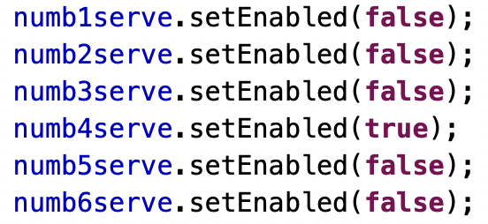
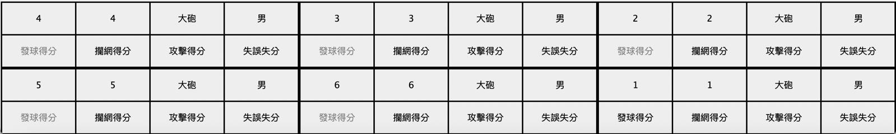
Introduction for Class and Logic{
Volleyball.html
Introduction.css
<SecondPage>
“若為敵方發球，我方得分按鈕關閉”
“若為我方球，非發球者之得分按鈕關閉”
“當自由球員在後排，其攔網得分按鈕關閉”
}
OOP Final Project 110-2

Slide 24
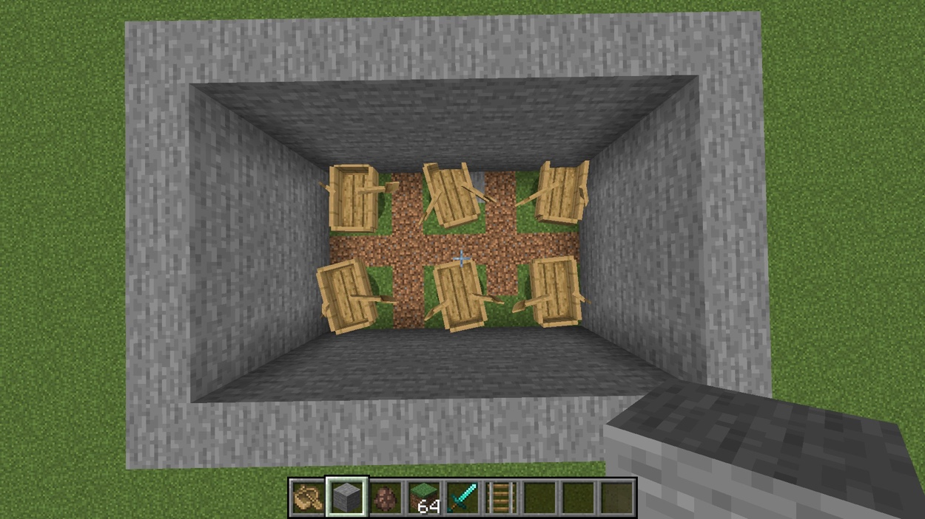
Introduction for Class and Logic{
Volleyball.html
Introduction.css
“Imagine moving the boats in Minecraft...”
<SecondPage>
“Using carriers to move the players and redraw the whole GUI”
}
OOP Final Project 110-2

Slide 25
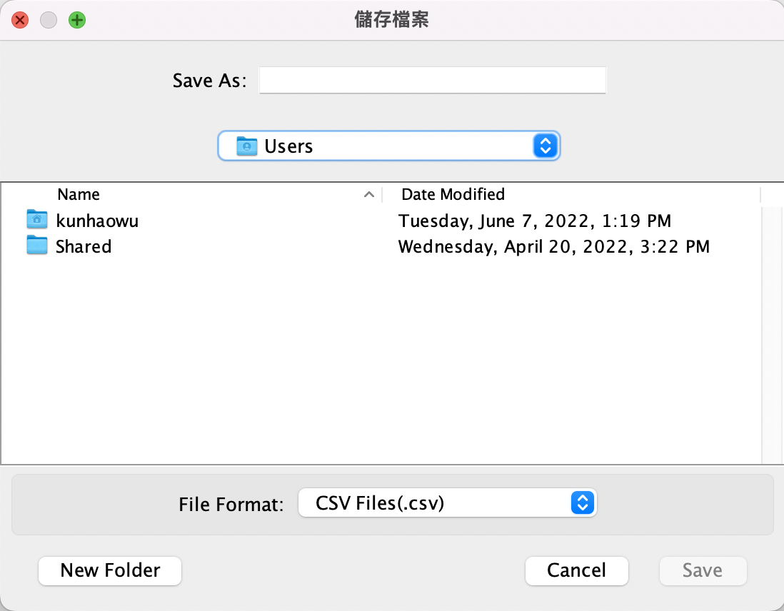
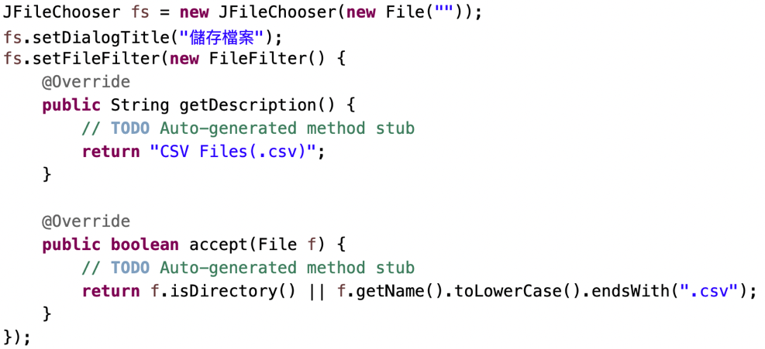
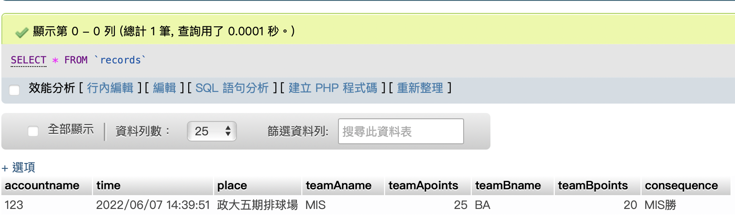
Introduction for Class and Logic{
Volleyball.html
Introduction.css
<SecondPage>
“Using JFlieChooser to output .csv files and upload to SQL at the same time”
}
OOP Final Project 110-2

Slide 26
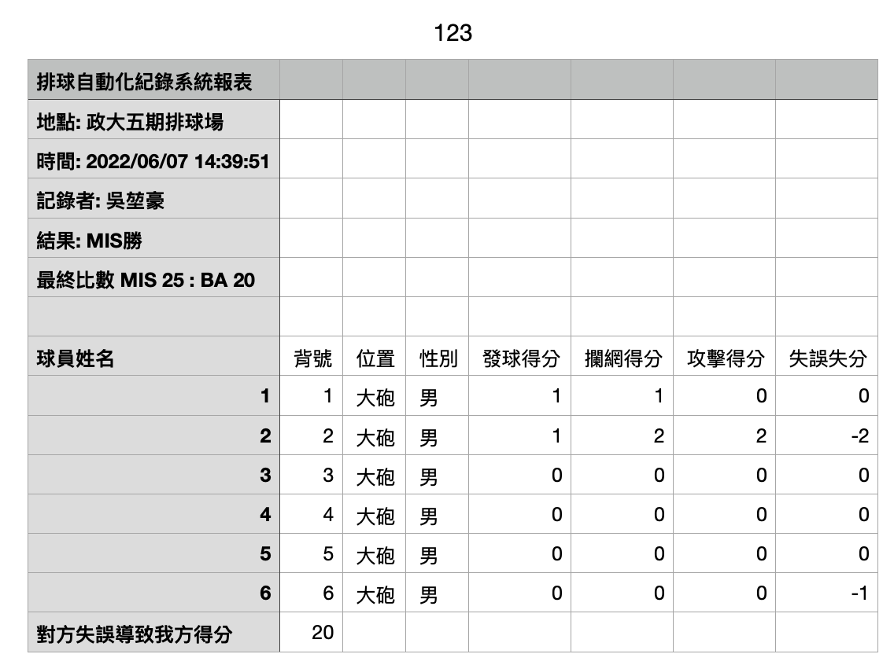
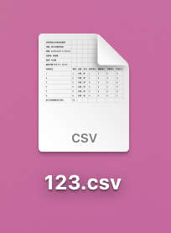
Introduction for Class and Logic{
Volleyball.html
Introduction.css
<SecondPage>
“How’s the output”
}
OOP Final Project 110-2

Slide 27
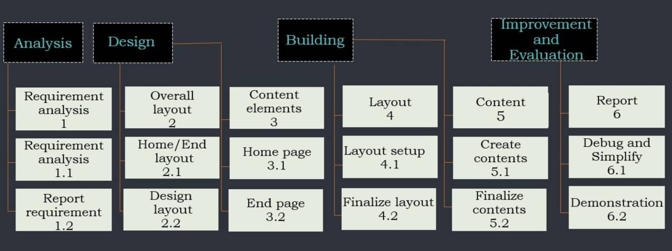
WBS{
Volleyball.html
Introduction.css
Automatic Recorder for Volleyball
}
OOP Final Project 110-2

Slide 28
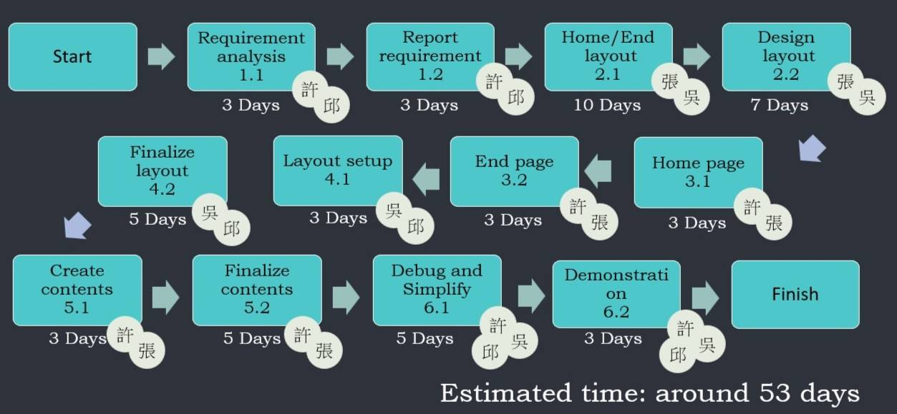
Task Network/Timeline{
Volleyball.html
Introduction.css
}
OOP Final Project 110-2

Slide 29
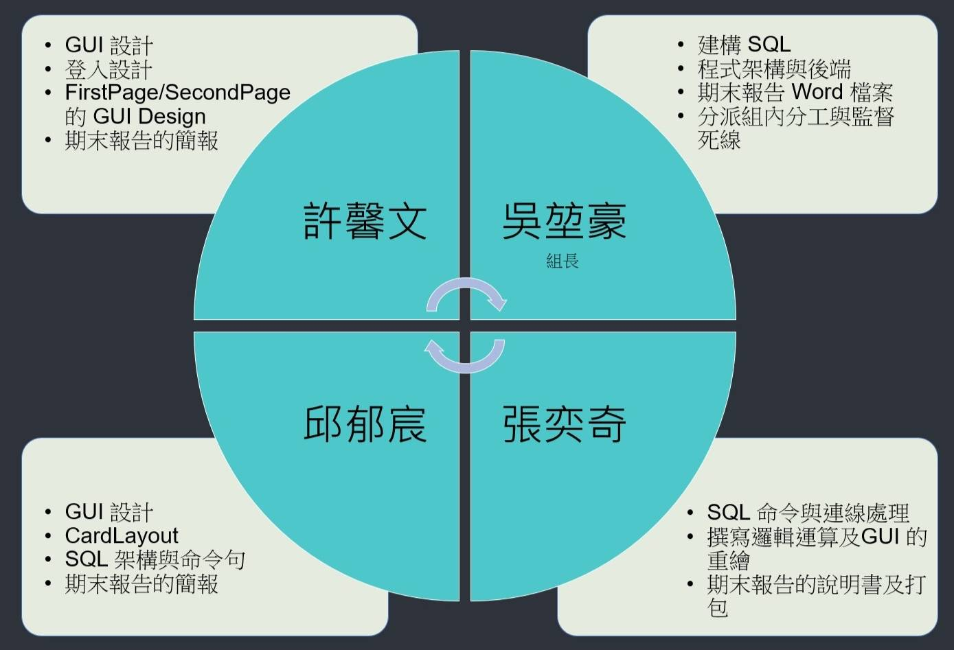
Teamwork{
Volleyball.html
Introduction.css
}
OOP Final Project 110-2

